Slide 1



DEPARTMENT OF COMPUTER SCIENCE AND ENGINEERING
MediAssist: Smart Symptom Checker and Hospital Suggester
VIGNESH S 220701318
YASHWANTH RAMESH 220701326
01

Slide 2

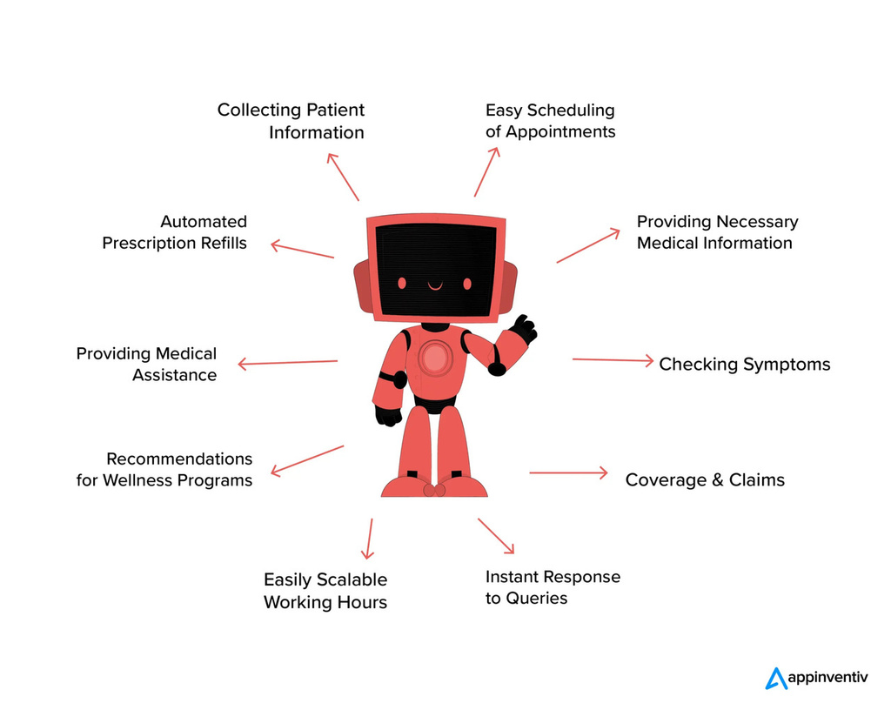


Studio Shodwe
PROBLEM STATEMENT
Many people, particularly the elderly, find it hard to understand their health problems and don’t know which hospital to go to. They also struggle with apps that are too difficult to use. There is no easy tool that listens to their symptoms, gives helpful advice, and shows nearby hospitals. So, we need a smart and simple system that helps people check their symptoms, get health tips, and find hospitals quickly.
MOTIVATION
We all know how scary it feels when we or our loved ones are sick and don’t know what to do next. Many people especially older adults get confused about their symptoms and are unsure whether to go to the doctor or which hospital to choose. Not everyone has someone to help them all the time. That’s why we wanted to create something that feels like a friend someone who listens, gives health tips, and shows nearby hospitals quickly. Our goal is to make health help easy, fast, and friendly for everyone.
02

Slide 3
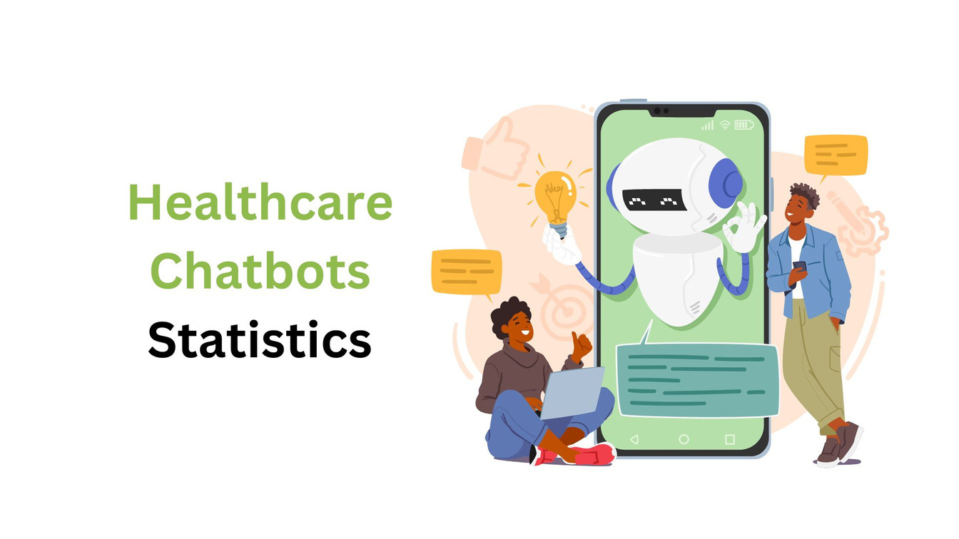

EXISTING SYSTEM
Right now, there are some apps and websites that help people check symptoms and find hospitals. Examples include WebMD, Mayo Clinic, and Google health search. These tools ask users questions and give health suggestions. But they have some problems:
They are not made for older people or for local needs.
Most of them don’t support voice input. Users have to type everything.
They give general advice, not based on the person’s exact condition or location.
They don’t have features like setting medicine reminders.
Hospital finders like Google Maps show nearby places, but they don’t suggest the best hospital based on the user’s symptoms.
Most systems use simple if-else logic, so they can’t really understand natural conversations like a real chatbot.
03

Slide 4
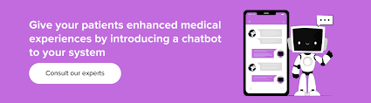
Studio Shodwe
OBJECTIVE
The main goal of this project is to create a smart and easy-to-use web app that helps people especially older adults check their symptoms, get health advice, and find nearby hospitals based on their condition and location. The system will also allow voice input, set medicine reminders, and give personalized support through a chatbot, making healthcare access faster and simpler.
04

Slide 5

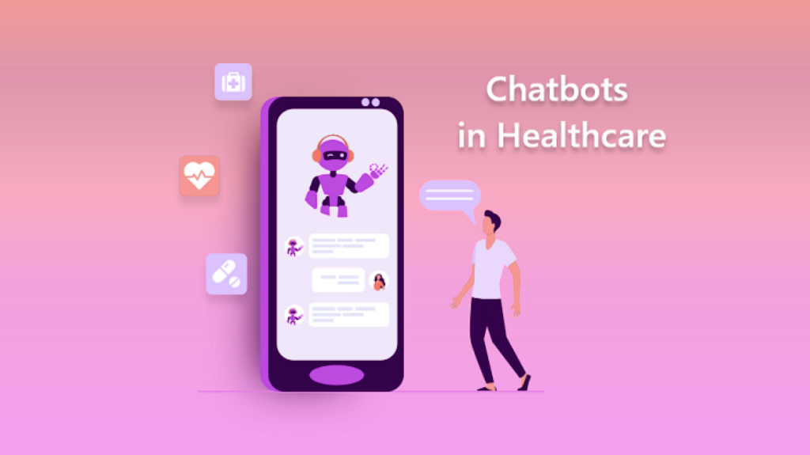

Studio Shodwe
ABSTRACT
MediAssist is a smart web-base healthcare chatbot designed to help users especially older adults get quick and reliable health support. The system allows users to enter their symptoms using text or voice. It then gives health advice based on the input and helps locate nearby hospitals based on the user’s location. The chatbot also includes useful features like setting medicine reminders, storing chat history, and offering a friendly, easy-to-use interface. Unlike existing tools, MediAssist provides personalized care by using AI to understand natural conversation and user needs. This project aims to make healthcare more accessible, especially for people who may struggle with using regular health apps.
01
05

Slide 6
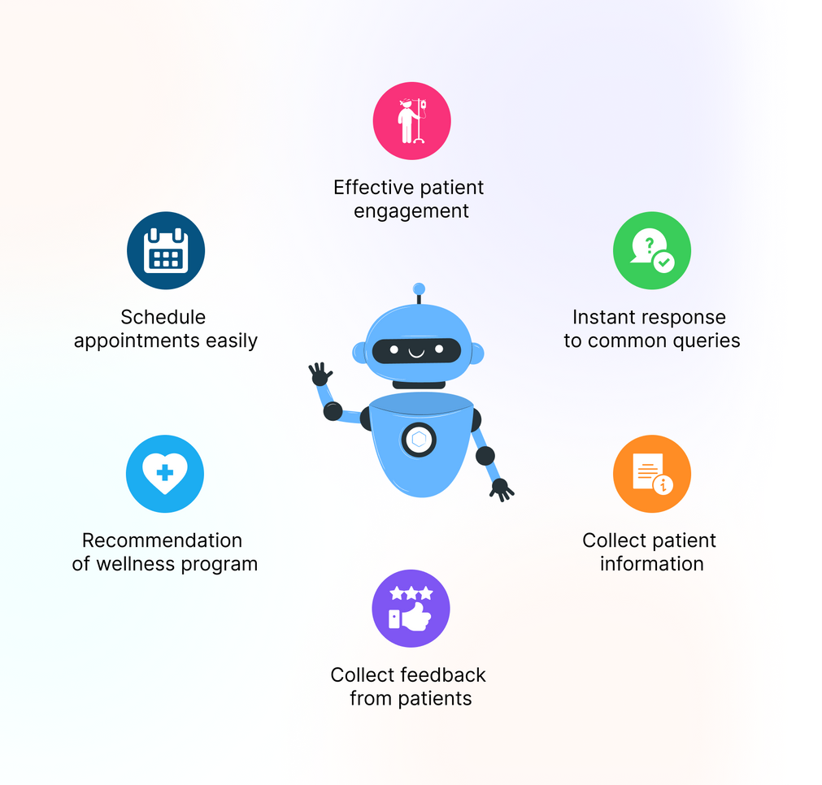
Studio Shodwe
PROPOSED SYSTEM
The proposed system is an AI-powered web application called MediAssist that helps users especially older adults check their symptoms and find nearby hospitals easily. The system includes the following features:
Voice and Text Input: Users can speak or type their symptoms, making it easy for older people to use.
Smart Health Advice: The chatbot gives personalized health suggestions using AI, based on the user's symptoms.
Hospital Finder: The system finds nearby hospitals based on the location and condition.
Medicine Reminders: Users can set reminders to take their medicines on time.
User-Friendly Design: The interface is simple, clean, and designed for easy use by older adults
01
06

Slide 7
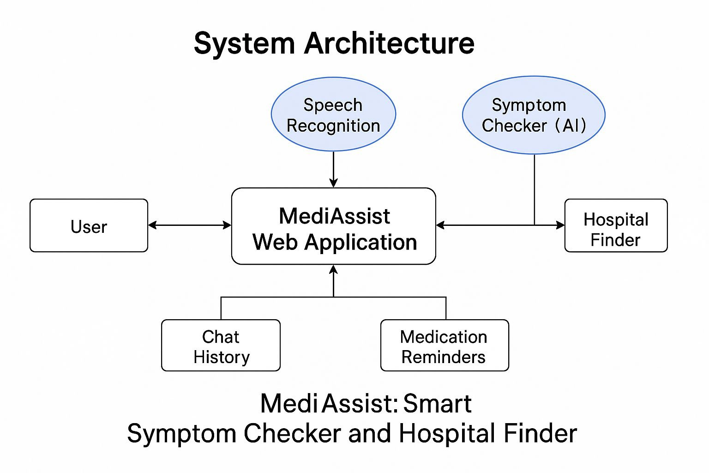
Studio Shodwe
SYSTEM ARCHITECTURE
07

Slide 8
Studio Shodwe
LIST OF MODULES
User Interface (UI) Module
Handles user interactions (text and voice input).
Displays health advice, hospital suggestions, and reminders.
Voice Input Module
Captures and processes voice input from users.
Converts speech to text for further processing.
Symptom Checker Module
Analyzes user input (symptoms) using AI to suggest possible health conditions.
Provides health advice based on the user’s symptoms.
Hospital Locator Module
Finds and displays nearby hospitals based on the user’s location and health condition.
Uses location data to suggest the most relevant hospitals.
Medicine Reminder Module
Allows users to set medication reminders (AM/PM format).
Sends notifications for reminders.
08

Slide 9
Functional Description for each modules with DFD
The activity diagram illustrates the flow of operations within the AI-based healthcare chatbot system. It starts when a user inputs their symptoms and location through a web interface. The system validates the input, and if symptoms are provided, it generates a structured prompt for the Gemini AI model. The AI processes this prompt and returns health advice, including diagnosis, recommendations, and lifestyle tips. Based on the user's location, the system also retrieves a list of nearby hospitals. The final output—AI-generated advice and hospital suggestions—is then displayed to the user. If input is invalid or an error occurs, the system returns an appropriate error message. This flow ensures a clear, responsive, and supportive user experience.The AI processes this prompt and returns health advice, including diagnosis, recommendations, and lifestyle tips.

Slide 10
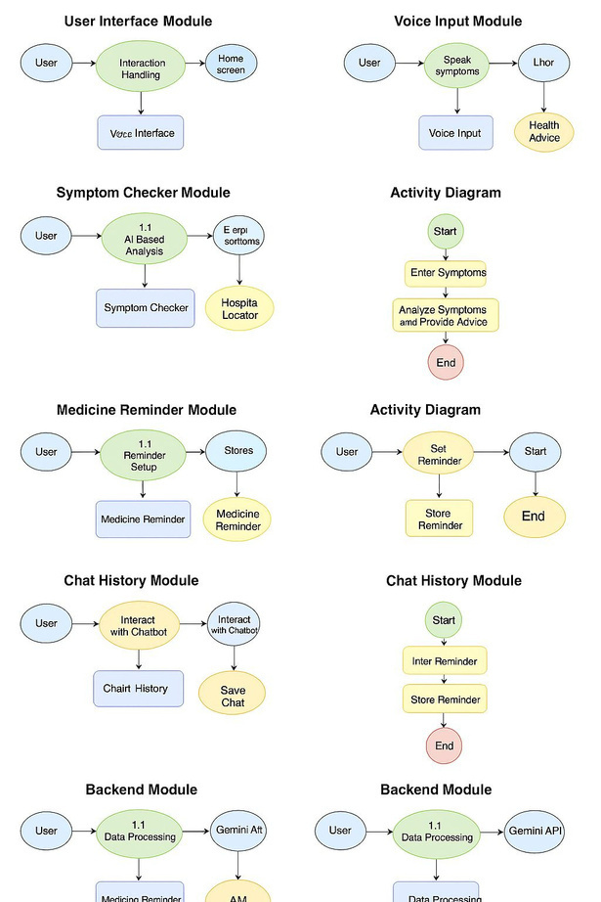
Activity Diagram

Slide 11

FUTURE WORK
In the future, the MediAssist system can be improved by:
Adding support for multiple languages to help users in different regions.
Integrating real-time doctor consultations via video or chat.
Using machine learning to improve the accuracy of symptom detection over time.
Adding emergency alert features to notify family members or nearby hospitals.
Creating a mobile app version for easier access on smartphones.

Slide 12

CONCLUSION
MediAssist provides a smart and user-friendly solution for healthcare support, especially for older adults. By combining AI-driven symptom checking, voice input, hospital finding, and medicine reminders, the system helps users get health advice quickly and easily. It reduces the need to visit a doctor for every small issue and supports early detection of common health problems. The chatbot’s simple interface and useful features make it a valuable tool in improving access to healthcare information.

Slide 13
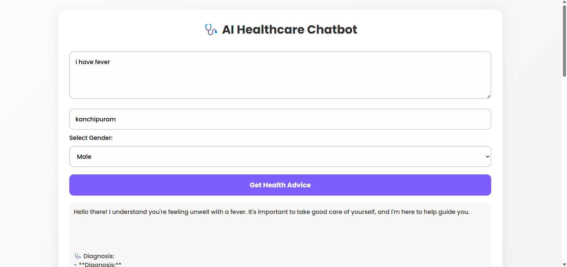
OUTPUT SCREENSHOT

Slide 14
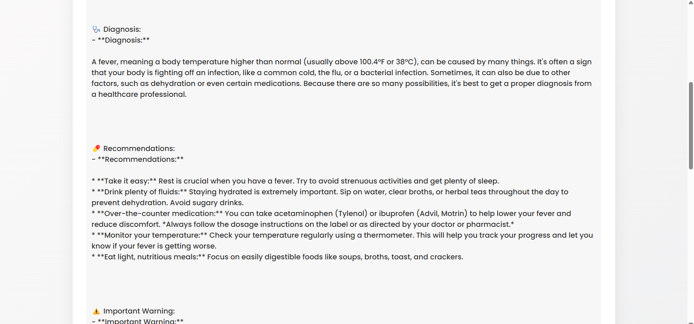
OUTPUT SCREENSHOT

Slide 15
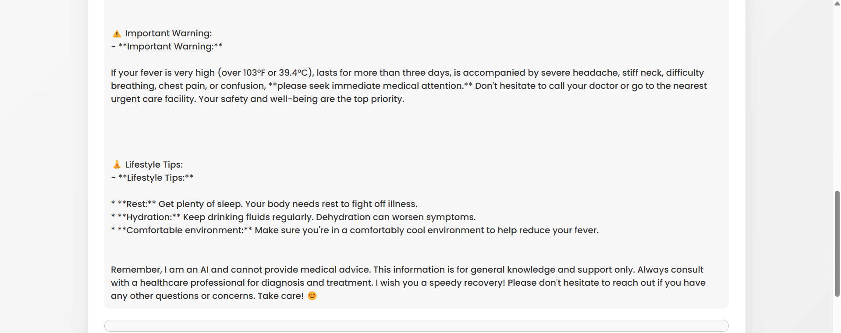
OUTPUT SCREENSHOT

Slide 16
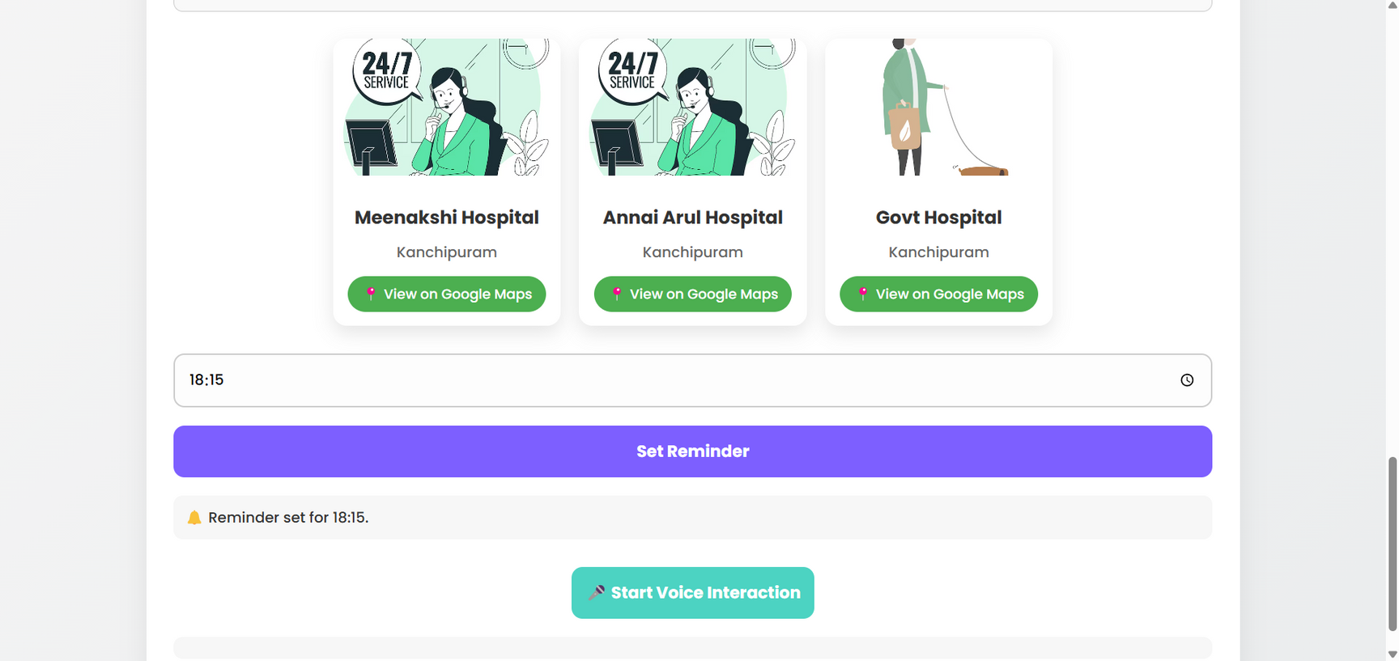
OUTPUT SCREENSHOT

Slide 17
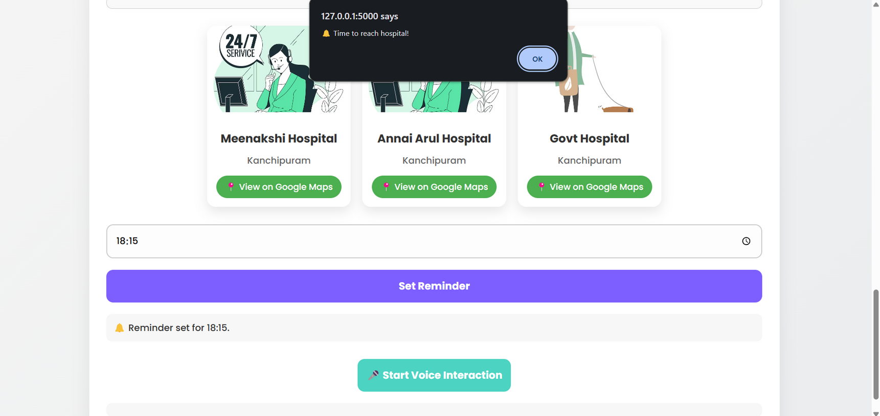
OUTPUT SCREENSHOT

Slide 18
Studio Shodwe
THANK YOU
10

